Slide 1

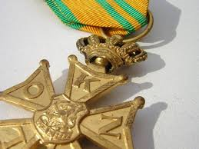
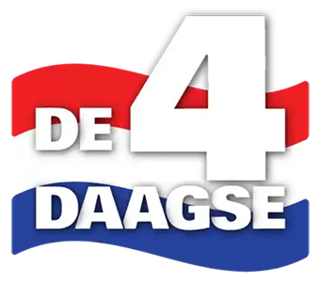
U.S. Delegation Nijmegen March (USDNM)
Marcher Training Briefing
4Daagse 2025, 15-18 July
USDNM Volunteers
Christopher Bulger cbulger.4daagse@gmail.com
Wednesday, 18 June 2025
1900 UTC+1
https://www.usnijmegenmarch.com

Slide 2
U.S. Delegation Nijmegen March (USDNM)
Training Brief
Purpose Holistic Health and Fitness (H2F) primer for Nijmegen and general fitness and training plans.
Task Discuss parts of the whole and their integration with marchers, provide references.
Agenda
Marching
Holistic Health and Fitness
Breathing
Posture
Mental
Pace
Injury
References

Slide 3
U.S. Delegation Nijmegen March (USDNM)
1. Marching
1.1. What is marching?
Marching is a holistic, endurance exercise.
Holistic Marching tasks the entire body, and its stress includes mental and spiritual domains.
Endurance Low intensity, long duration exertion that leverages and reveals holistic strengths and weaknesses.
Army physical fitness focuses on short duration, explosive output and general fitness. While appropriate to most physical tasks, it leaves endurance fitness to the individual.
Endurance expands on general fitness. However, by exceeding norms, endurance reveals holistic factors that general performance doesn’t challenge. Endurance can strengthen “big picture” fitness, and benefit general health.
1.2. The challenge: training holistically (in a garrison/civilian environment).
- Although fitness is holistic, workout routines focus on parts, not the whole.
- Resources that guide incorporation of parts into the whole are scarce. Practical advice is rare.
- Most experience is first-hand, difficult to disseminate. Some aspects are unappreciated in the general populace.
- Endurance training takes time. A lot of time.
Our answer: just do it. Improve continuously.
- Our advice is advice only. We are experienced amateur athletes, not professional sportsmen, trainers or healers.
- We are U.S. Servicemembers, and have an expectation of adequate fitness, mindset, and discipline.
- We can speak as military professionals, by definition athletes, who need to be/know/do holistic endurance.
1.3. Nijmegen
- Nijmegen is “administrative”, meaning not a tactical or approach march with security and formation concerns.
- The 4-day is arguably the most rigorous endurance march in the military training calendar.
“A foot march is successful when Soldiers arrive at their destination at the prescribed time and are physically and mentally able to execute their mission immediately. Physical and mental conditioning are normally done through unit conditioning programs and acclimatization of Soldiers to an area of operations (AO).” ATP 3-21.18, 1-2.

Slide 4
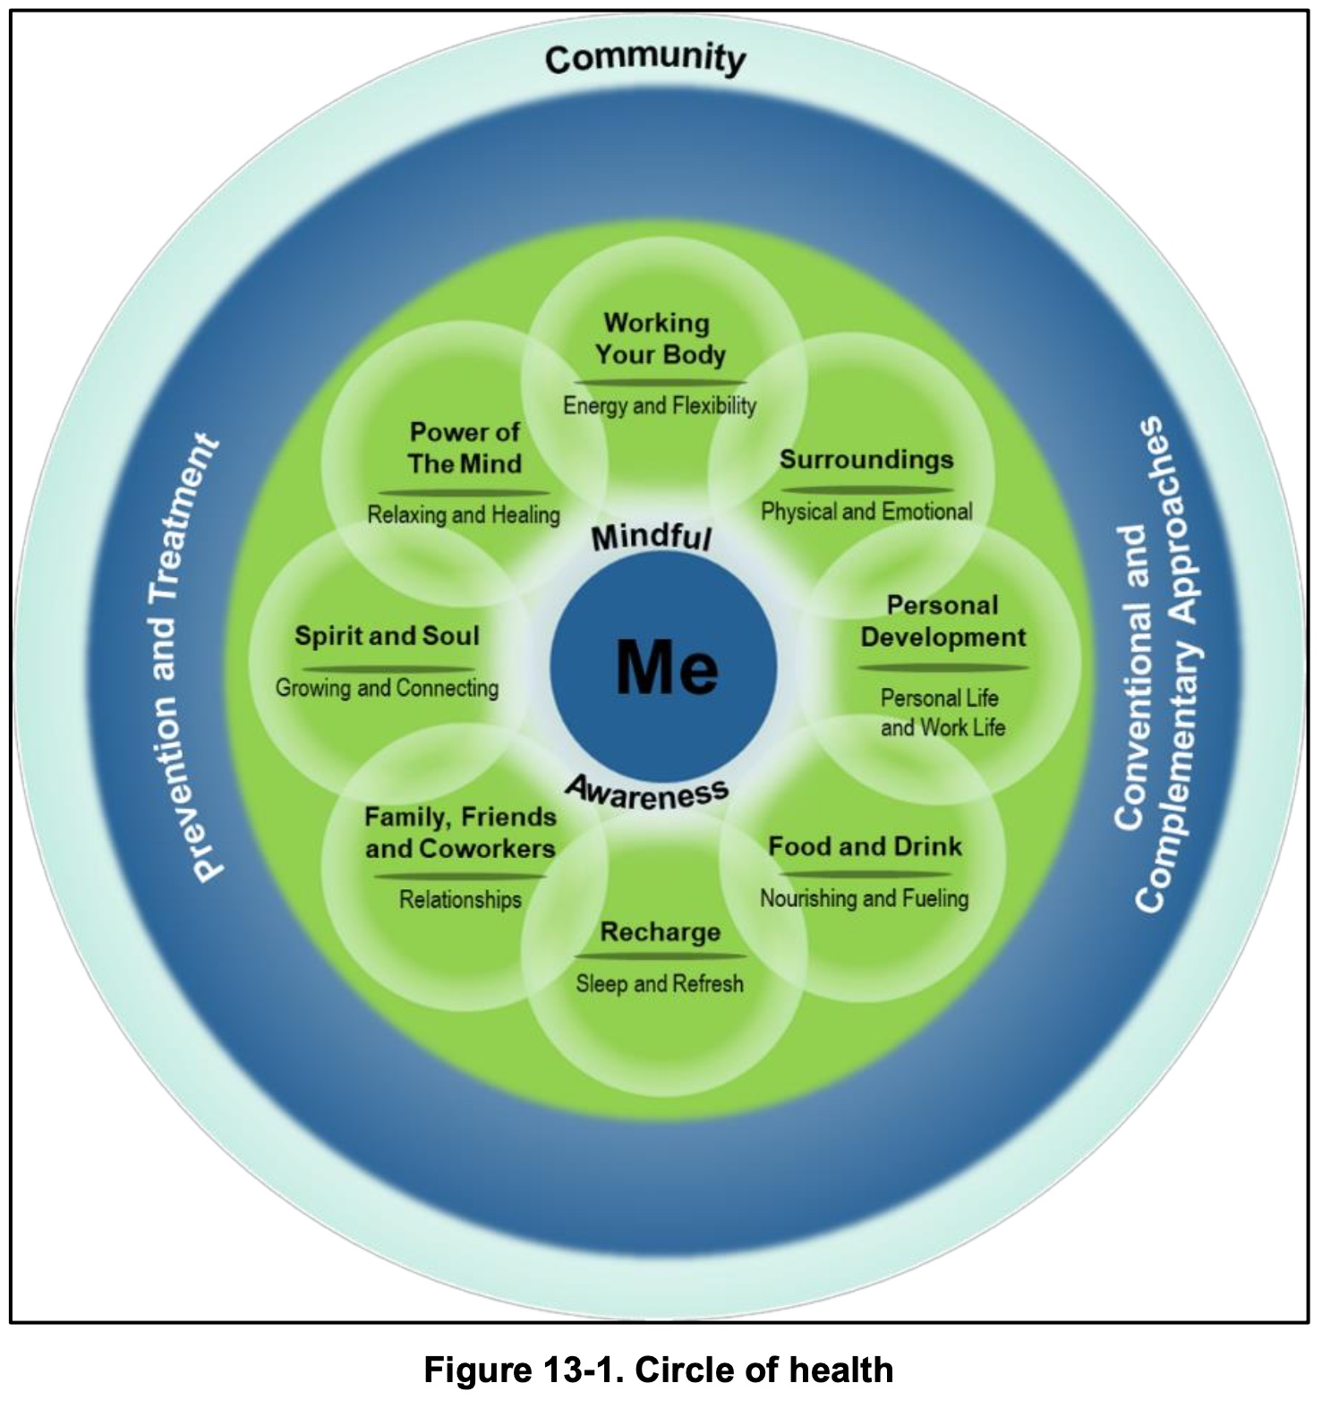
U.S. Delegation Nijmegen March (USDNM)
2. Holistic Health and Fitness (H2F), Field Manual IFM) 7-22
1-1. The H2F System formalizes the way the Army trains, develops, and cares for Soldiers. This shift marks a change that will continue to evolve over the next twenty to thirty years. The H2F System builds both the underlying capability and capacity within the Soldier. Similar to professional athletes, Soldiers will optimize their individual performance potential and well-being by becoming stronger, faster, and more ready in both the physical and nonphysical domains. Stronger individuals ultimately produce stronger teams.
1-6. For most of its history, the Army has used an industrial-scale approach to physically train its formations. The optimal physical fitness of the individual was constrained by the need to raise the fitness of the whole. H2F doctrine shifts the focus to individualized training programs with continuance of training in a collective setting…. The H2F System supports that approach with expert H2F performance teams, equipment, and facilities. It uses the best exercise science and best coaching practices to assess each Soldier and customize to his or her needs. Each Soldier, regardless of physical condition, has his or her own program. A periodized, purposeful physical training program implemented across the enterprise allows Soldiers to move from one duty station to another without interruption in their readiness training progression.
1-7. Training schedule development for individual Soldiers and units is a complex process. Several variables impact the ability to apply one training schedule across all of the Army. These variables include how units fill, the length of the training cycle, time until deployment, cadre-to-Soldier ratios, shift work, availability of H2F personnel, equipment and facilities, military occupational specialty (MOS)-specific training, and environmental (austere, hot, cold, and seasonal) considerations. The H2F System will provide the best training approaches to accommodate these variables and implement rational, optimized programs.

Slide 5
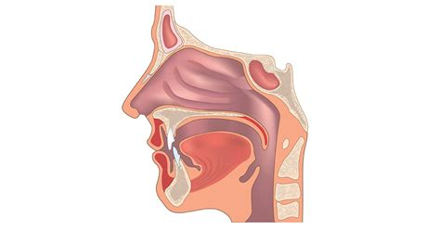
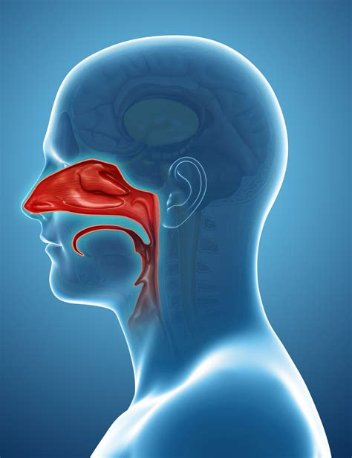
U.S. Delegation Nijmegen March (USDNM)
Breathing
Because breathing is possibly least appreciated and one of the most impactful fitness practices, it is perhaps the highest leverage practice you can incorporate into your life/workout routines.
3.1. Nasal
The nose is your breathing organ. Your mouth is not. Nasal breathing has an estimated 31 unique functions:
- Filters, humidifies, and enriches air.
- Constricts air intake, thereby increasing CO₂ saturation, which optimizes O₂ exchange.
- Generates Nitric Oxide (NO), crucial for vascular function.
- Facilitates proper posture.
Benefits include
- Improve sleep (snoring is impossible if breath posture is correct)
- Mitigate/eliminate asthma
- Improve weight loss
- MORE POWER
3.2. Breath
Breath into the gut, not the chest. Use the diaphragm correctly for optimal power, control.
3.3. Heart Rate
Breathing affects the autonomous nervous system directly, giving you indirect control of your heart rate.
3.4. Timing
- Deep and shallow breathing have respective advantages.
- For marching, long, slow, deep (LSD) breathing is optimal.
3.5. Training
- “Air Hunger” is healthy
- Body Oxygen Level Test (BOLT)
- “Square” Breathing – five second inhale / hold / exhale / hold
Patrick McKeown https://oxygenadvantage.com
James Nestor all over YouTube

Slide 6

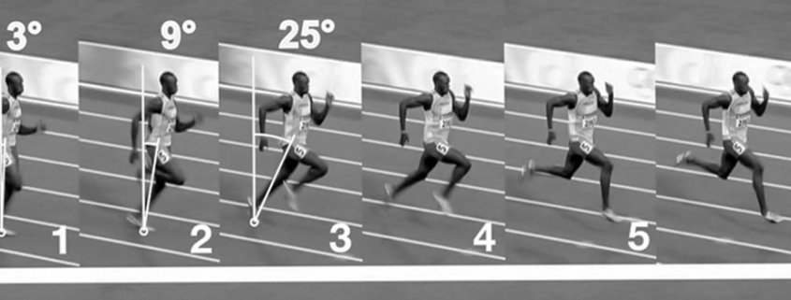
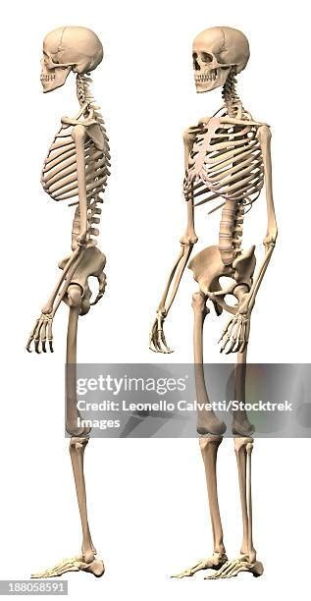
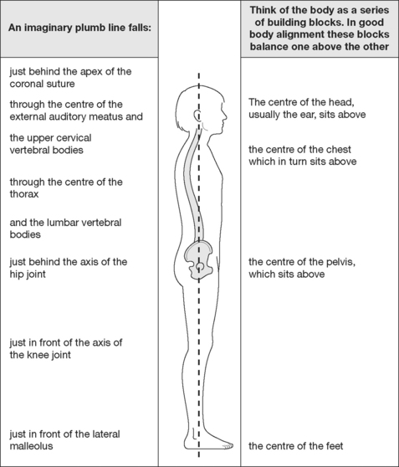
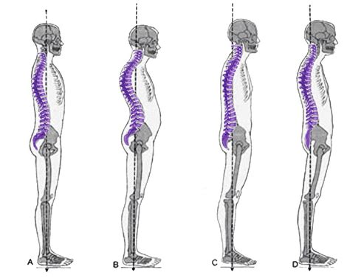
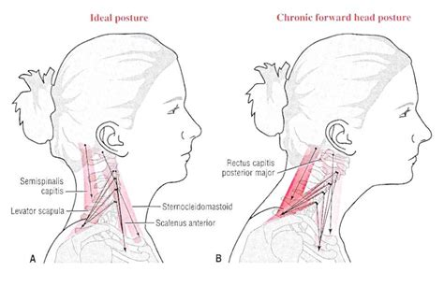
U.S. Delegation Nijmegen March (USDNM)
4. Posture
Because posture is another underappreciated yet decisively impactful fitness aspects, it is another high leverage practice you can incorporate into your life/workout routines.
- “Pose” Method is Army running doctrine since OCT 2020.
LEAD with the head (chin)
FALL into next step
4.1. Head/Neck
- Skull should sit ATOP spinal column.
- Forward head posture is a chronic modern condition.
- Two inches off center is stress equivalent to a small child
on shoulders. This is the mass of your marching kit.
4.2. Core
- EVERYTHING is a core exercise.
- Spinal column should sit ATOP pelvis.
- Breath into navel
4.3. Hips
- Often rotated out of alignment, contributes to chronic
BACK PAIN.
4.4. Legs
- In balance, stress flows up/down, minimal knee movement, minimal stride.
- Imbalance
- strains knee, hip and back
- strains tendons, sinews
- muscles have to substitute
4.5. Foot
- 25% of the human’s 206 bones are in the feet. If your posture is out of balance, your feet will have to do much more than 25% of the body’s load-bearing.
- There is no substitute for endurance training. The connective soft tissue is exercised only with exercise.
Usain Bolt and the „pose“ posture
https://posemethod.com/usain-bolts-running-technique/
https://militaryrunning.com
https://posemethod.com

Slide 7


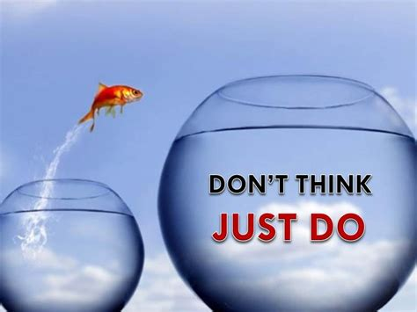
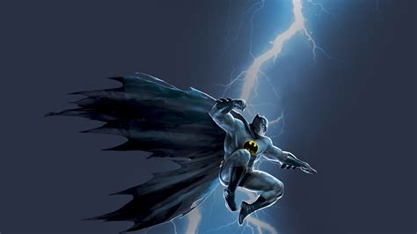
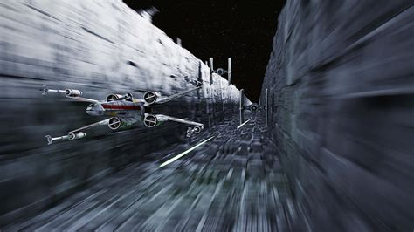
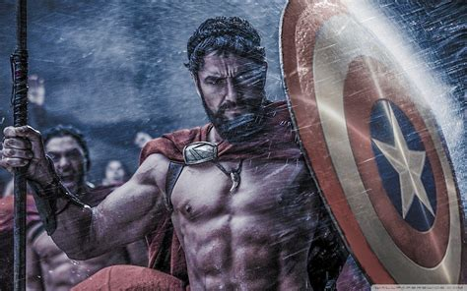
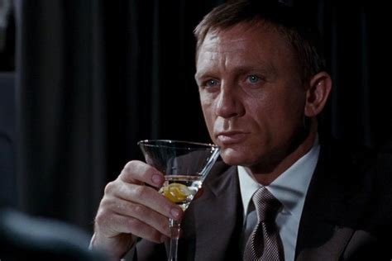
U.S. Delegation Nijmegen March (USDNM)
Mental Readiness…
… the capacity to adapt successfully in the presence of risk and adversity. It can be seen as a set of personality traits, an assortment of skills or ways of behaving and thinking, or a combination... Whether Soldiers think of mental readiness as something they have (such as a personality trait or disposition), something they do (such as a plan, strategy, or way of behaving), or something they believe (such as a faith, positive outlook, or neutral outlook), it will help Soldiers better understand uncertain situations and will make them aware of their own mental processes. 3-9.
Under extreme duress, mental readiness is the ability to create a sense of total control and confidence.... Soldiers who are mentally ready can manage severe stress and grow mentally tougher in the process. 3-10. FM 7-22
Dr Nate Zinsser, West Point Sport Psychologist (The Confident Mind)
“… confidence is this: a sense of certainty about your ability which allows you to bypass conscious thought and execute unconsciously. … Confidence is that feeling that you can do something (or that you know something) so well you don’t have to think about how to do it when you’re doing it. That skill or knowledge is in you, it’s part of you, and it will come out when needed if you let it.” (8-9)
So: how do you LEARN things so well you can DO them INSTINCTIVELY? And: how do you manage PAIN and FEAR?
5.1. Visualize positive outcomes, your endstate.
5.2. Compartmentalize emotions.
5.3. Segment task into mental horizon.
5.4. Zen focus, become one with the moment, be in the moment. “Mindfulness”.
5.5. Dissociation. Conscious awareness separates from unconscious performance. Can lead to amnesia, trauma responses.
5.6. Narration – tell your story.
Spiritual readiness is the ability to endure and overcome… by making meaning of life experiences. Individuals find meaning as they exercise beliefs, principles, ethics, and morals arising from religious, philosophical, and human values… 3-21. Spiritual readiness strengthens as individuals identify their spiritual dimension—their purpose, core values, beliefs, identity, and life vision. The spiritual dimension draws on an individual’s core religious, philosophical, or human values to develop an individual’s sense of motivation, character, and integrity. The spiritual dimension defines the essence of a person by enabling one to build inner strength, make meaning of experiences, behave ethically, persevere through challenges, and be resilient when faced with adversity. 3-22. FM 7-22
References: MUSIC!
Notes:
MCKEOWN, Patrick. 2021. The Breathing Cure: Exercises to Develop New Breathing Habits for a Healthier, Happier and Longer Life. OxyAt Books.
MCKEOWN, Patrick. 2015. The Oxygen Advantage: the Simple, Scientifically Proven Breathing Technique that will Revolutionise your Health and Fitness. Piatkus, an imprint of Litte, Brown Book Group.
NESTOR, James. 2020. Breath : the New Science of a Lost Art. Riverhead Books, an imprint of Penguin Random House LLC.
BRULÉ, Dan. 2017. Just Breathe: Mastering Breathwork. Enliven Books, an imprint of Simon & Schuster, Inc.
ZINSSER, Nathaniel. 2022. The Confident Mind: a Battle-Tested Guide to Unshakable Performance. Penguin Random House.
EDE, Georgia. 2024. Change Your Diet, Change Your Mind: a Powerful Plan to Improve Mood, Overcome Anxiety, and Protect Memory for a Lifetime of Optimal Health. Yellow Kite, an imprint of Hodder & Stoughton Ltd.
VAN DER KOLK, Bessel. 2014. The Body Keeps the Score: Brain, Mind and Body in the Healing of Trauma. Penguin Random House.

Slide 8
U.S. Delegation Nijmegen March (USDNM)
Pace
Pace, or cadence, is perhaps the most familiar marching calculation. We will now consider it holistically. Of course, pace is an on-g going calculation adjusted to situation. There is no one solution. It requires constant monitoring and adaptation (use METT-TC).
1. Hydration think: ELECTROLYTES
1 quart (0.95) liter per hour is the upper limit for endurance activity in daylight at normal day temperatures.
- If you need more, you may be in trouble. Stop, rest and eat, especially salts.
- A clear urine stream can indicate proper hydration AND absence of electrolytes. How do you feel?
- If don’t drink enough, you will get in trouble. Danger to life is possible.
- For Nijmegen, sip every 20 minutes. When hot/humid, every 15. If exceptionally hot/humid every 12.
2. Nutrition think: INSLULIN
DO NOT MARCH NIJMEGEN FOR WEIGHT LOSS.
The average marcher will burn 400-500kcal per hour on the move.
- Snack every 30 minutes, at least every 60. Keep energy flow constant.
In general, your body burns either fat or sugar, not both simultaneously.
- Fats (proteins) are your most effective energy source. Meat, fatty foods, some dairy (cheese), protein bars.
- Sugars trigger insulin, which stops fat burns (and promotes storage) until sugar levels decrease bellow exercise needs.
- Fruits are excellent sugar fuel, but all things in moderation.
- Carbohydrates decompose to sugars. Too many carbs may trigger insulin, which will switch body to sugar until exhausted.
3. Tempo
6.5kmh is often “best possible” speed (unless you’re German, more like 7.5kmh)
5.5kmh will get the march done without excessive fatigue.
4.5kmh will just get it done, but may induce greater fatigue.
TAKING BREAKS WILL INCREASE TEMPO. Try 10min every hour (as per reg).
4. Maintenance
Risk to sustaining performance are cumulative micro-injuries, loss of strength, and too long recovery periods.
- Alter conditions to mitigate cumulative injuries. Change socks. Change insoles. Change boots. Shift should straps.
- THE WALL. Usually after 30km, the body exhausts power, hits “the wall”. Proper pacing can prevent/mitigate this.
- Incorporate yoga stretches into breaks.
- Warm up and cool down. You might not feel it now, but you will later. After march, run very lightly for 5-10 minutes.

Slide 9
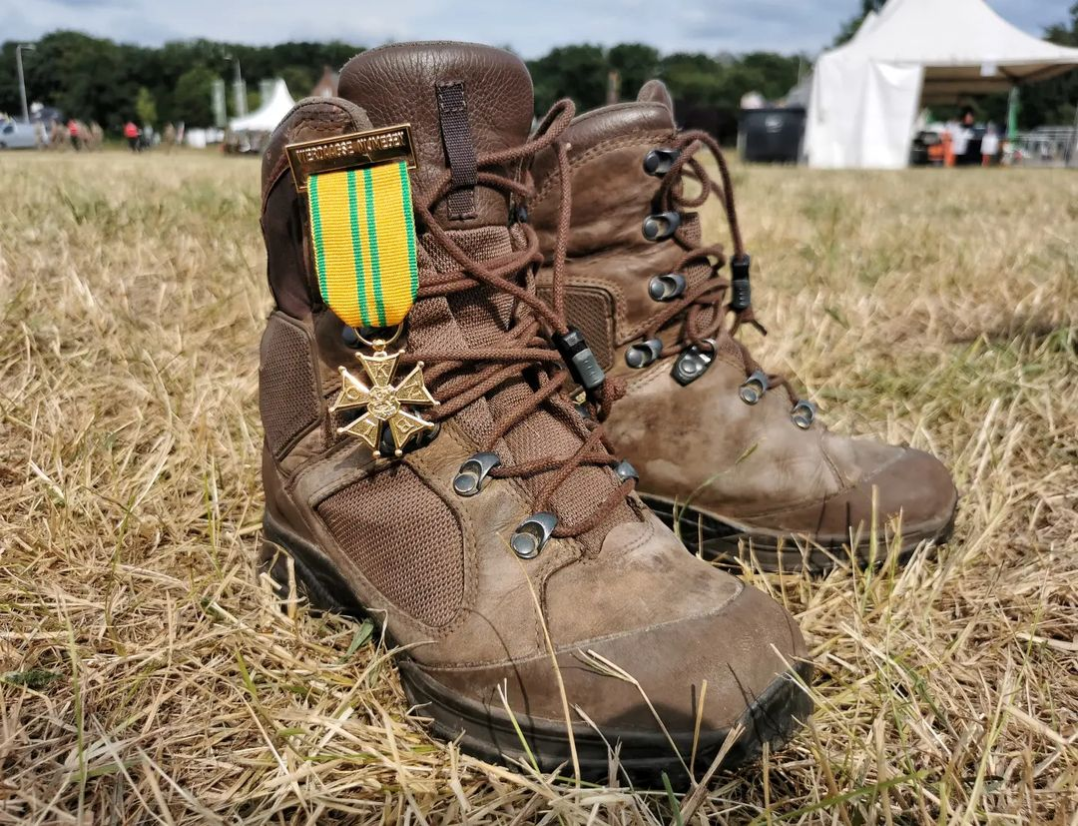

Nijmegen March 2025
SGT Hollingsworth
68W Combat Medic- U.S. Army
U.S. Delegation Nijmegen March (USDNM)
Injury Prevention and First Aid

Slide 10
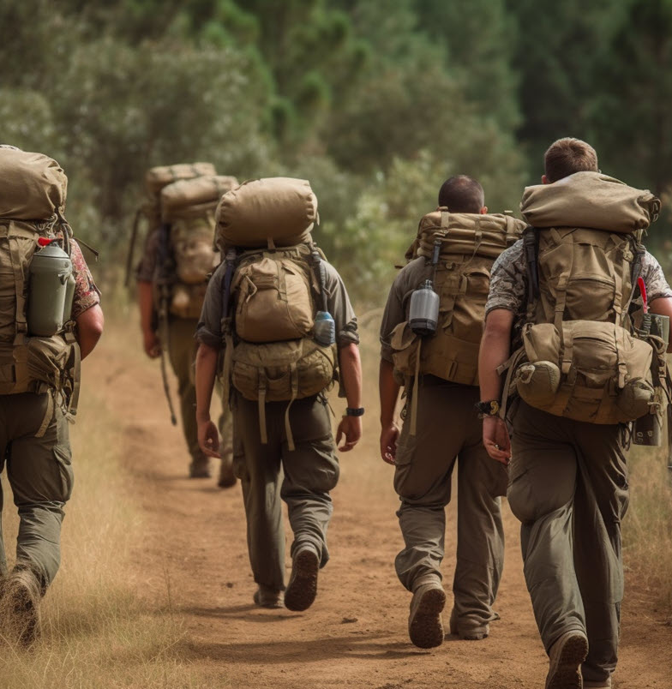
Train up and knowledge
U.S. Delegation Nijmegen March (USDNM)
Prior to participation in the Nijmegan march, you and-or your team ideally performed some form of train up.
This training period should have identified weaknesses in skin, tendons, muscles, etc.
You should know before this march where you get hot spots, what socks and boots work best for you, and what limiting factors you have physically.
Do not skimp out (be cheap) on your boot and sock wear.
You are putting 160 Kilometers on your feet in less than a week, treat them with the highest quality material possible.

Slide 11
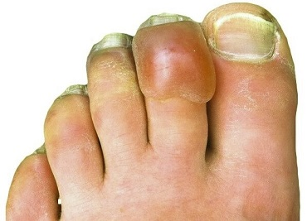
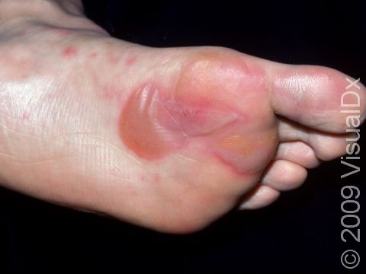
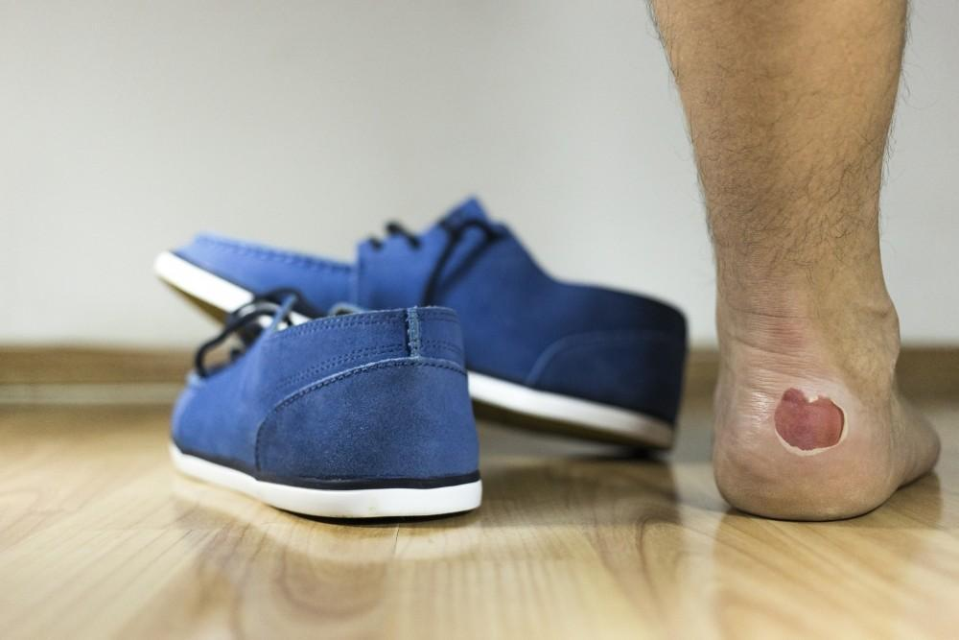
Don’t “Wing It”
Don’t be this person on day 2
U.S. Delegation Nijmegen March (USDNM)

Slide 12
How to wrap
U.S. Delegation Nijmegen March (USDNM)
https://youtu.be/lIvLRG31MZI?si=lszdnrz7ecf71s9H (general blister care)
https://youtu.be/jRnpbBKwSfc?si=Lf6HfV395QbV81kL (KT Tape- Knee)
https://www.youtube.com/watch?v=kglKIZivnDA&pp=ygUkaG93IHRvIHdyYXAgZWxhc3RpYyBiYW5kYWdlIG9uIGFua2xl (KT Tape-Ankle)
I recommend utilizing KT tape as a supporter more than elastic bandage, due to the bulk that comes with elastic bandage wraps.

Slide 13
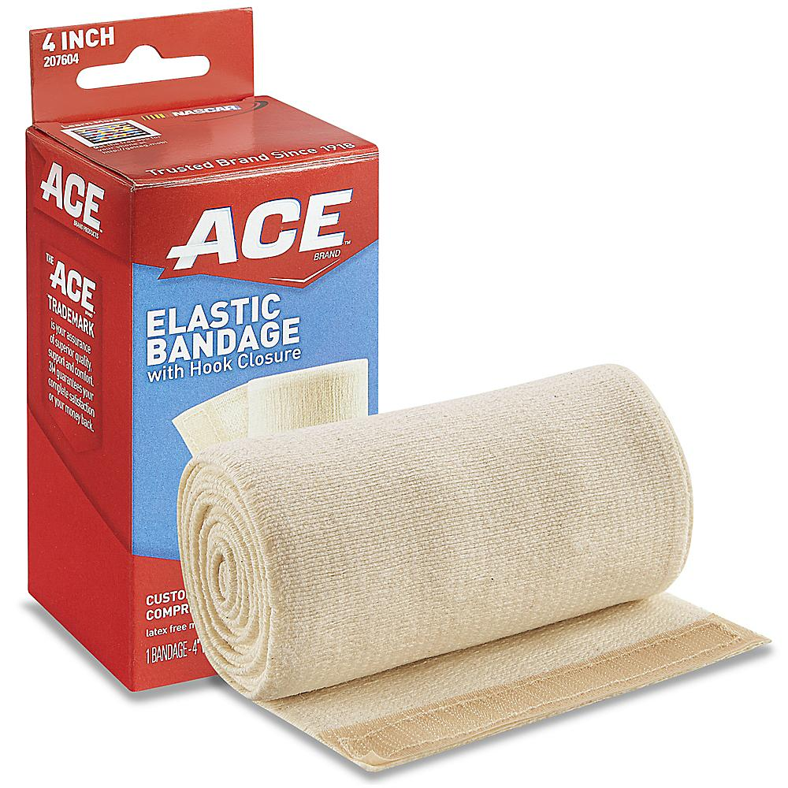
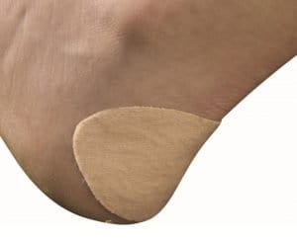
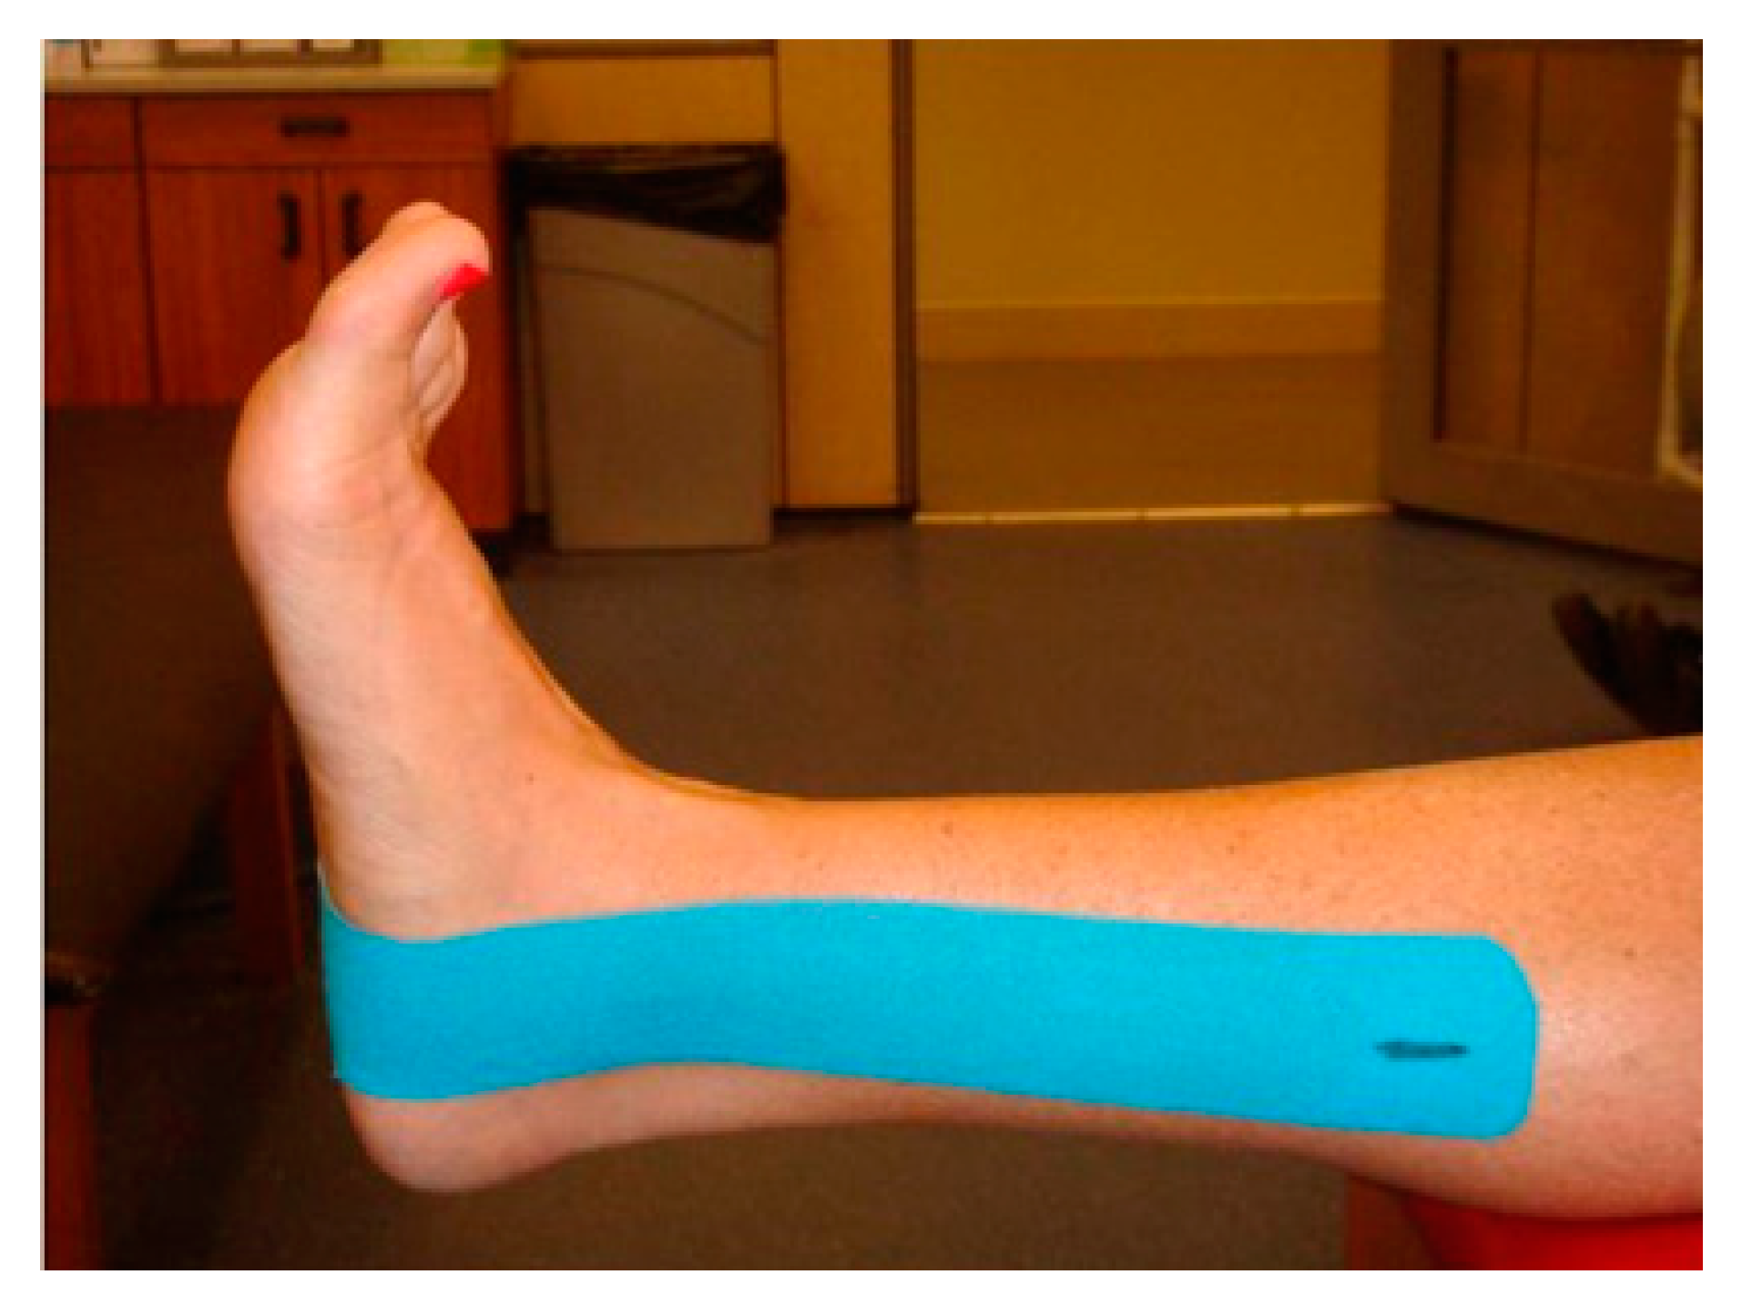
Injury Prevention
Wraps and Second Skin
U.S. Delegation Nijmegen March (USDNM)
For muscle and joint support, you can and should utilize wrap material for this march.
This material can range from KT (kinesiology therapeutic tape) to elastic bandages.
For blisters and hot spots, you can and should utilize “Second Skin” or blister wraps.
There are many different brands for blisters that you can acquire from your local pharmacy or first aid stores.
*Leukotape seems to be popular/effective.
Notes:
Leukotape (Brand Name) – very sticky, doesn‘t peel, rub
In combination with moleskin (thin version)

Slide 14
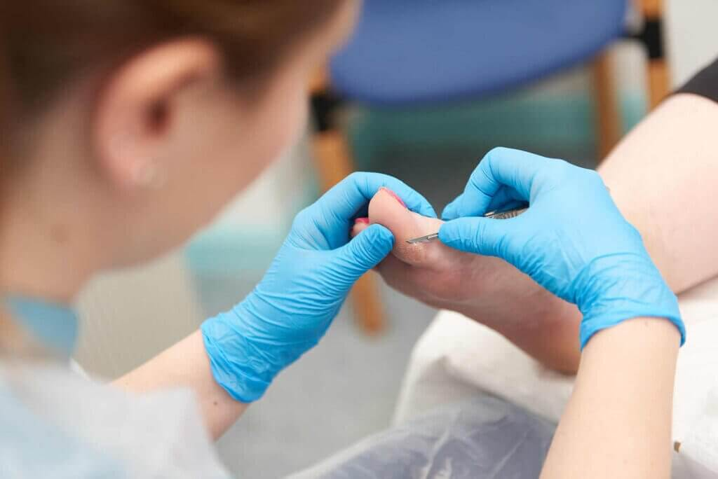
Blister Considerations
U.S. Delegation Nijmegen March (USDNM)
In good health practice, you DO NOT pop blisters.
However, in the event you build up a blister full of fluid, see your local medics or providers so they can drain and treat it as clean as possible.
Do not scrape at or peel blisters away, this will MAKE the INJURY WORSE.
The purpose of draining is so you can continue with the foot march, without massive discomfort or further blister build up.

Slide 15


Hydrate!!
U.S. Delegation Nijmegen March (USDNM)
Men should be ingesting around 15 cups of water a day, Women should be ingesting around 12 cups
These numbers are for AT REST MINIMUM !!
Liquid I.V. and Drip Drop should be supplemented in your hydration throughout march
HOWEVER! Do not use it continuously all day with every cup, as this can cause an electrolyte imbalance
Consult with your medic or provider on how much electrolyte supplement (liquid IV/ Drip Drop) you should take throughout the day

Slide 16

Change. The. Socks.
U.S. Delegation Nijmegen March (USDNM)
If you don’t want those nasty blisters and itchy feet sneaking up on you, CHANGE YOUR SOCKS.
The purpose of changing socks is to keep your feet as dry as possible, reducing friction.
You are already providing plenty of friction and mileage for your feet with this march.
Be kind to your feet and they will be kind to you.
Neglect them and they will neglect you too.

Slide 17
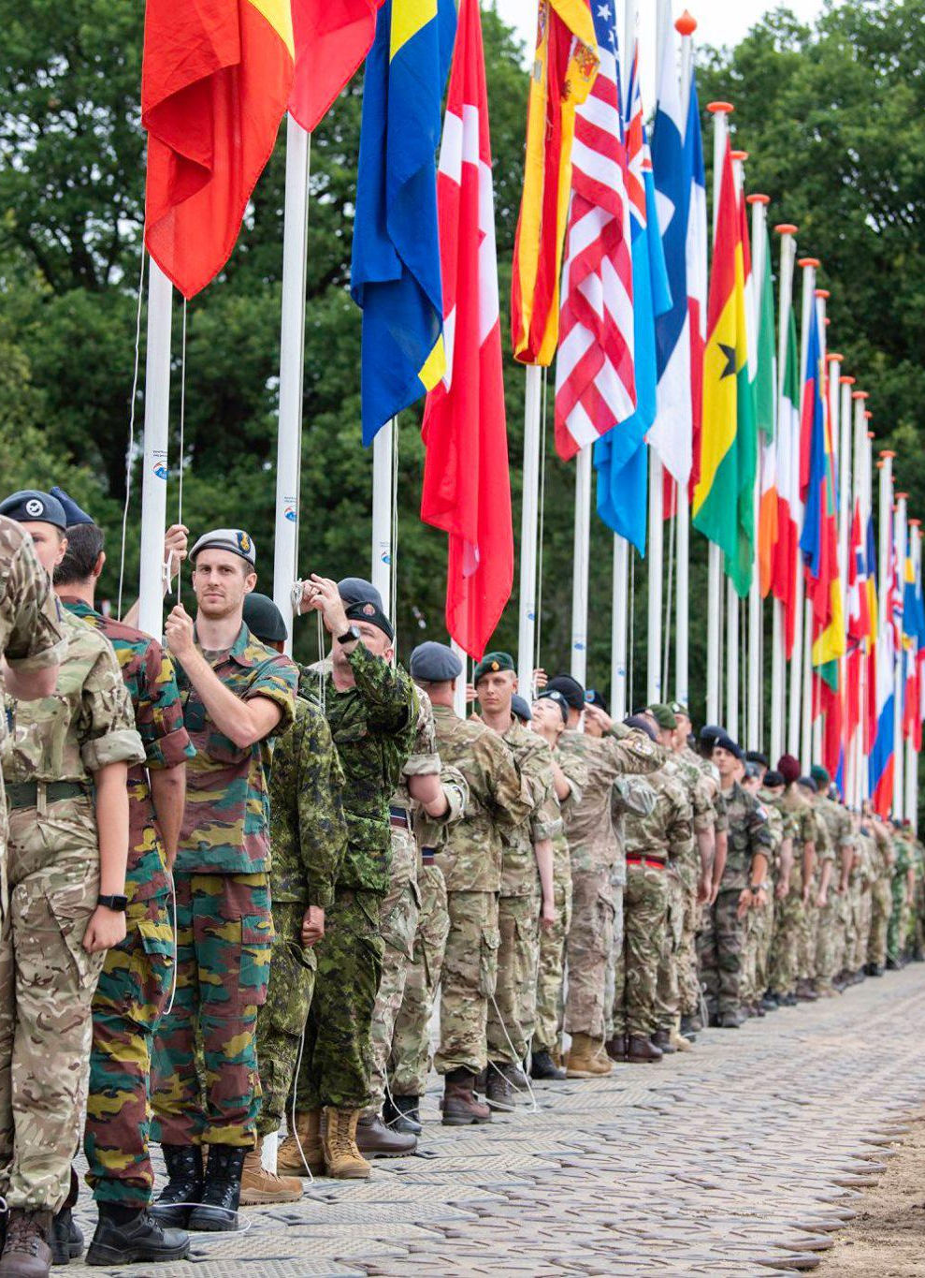
Push Through!
U.S. Delegation Nijmegen March (USDNM)
Nijmegan hosts over 10,000+ people from all over the globe. Civilians and military personal representing multiple countries.
No matter your reasoning in participating in the Nijmegen March, we are all participating in a long legacy together.
Please, have fun and exchange cultures.
Push through to the end with one another!
Be the best representation of your country that you know you can be!

Slide 18
U.S. Delegation Nijmegen March (USDNM)
8. REFERENCES
Army Techniques Publication (ATP) 3-21.18, Foot Marches, 20220413
(Army) Field Manual (FM) 7-22, Holistic Health and Fitness, 20201001
Army Techniques Publication (ATP) 7-22.02, Holistic Health and Fitness Drills and Exercises, 20201001
MCKEOWN, Patrick. 2021. The Breathing Cure: Exercises to Develop New Breathing Habits for a Healthier, Happier and Longer Life. OxyAt Books.
MCKEOWN, Patrick. 2015. The Oxygen Advantage: the Simple, Scientifically Proven Breathing Technique that will Revolutionise your Health and Fitness. Piatkus, an imprint of Litte, Brown Book Group.
NESTOR, James. 2020. Breath : the New Science of a Lost Art. Riverhead Books, an imprint of Penguin Random House LLC.
BRULÉ, Dan. 2017. Just Breathe: Mastering Breathwork. Enliven Books, an imprint of Simon & Schuster, Inc.
ZINSSER, Nathaniel. 2022. The Confident Mind: a Battle-Tested Guide to Unshakable Performance. Penguin Random House.
VAN DER KOLK, Bessel. 2014. The Body Keeps the Score: Brain, Mind and Body in the Healing of Trauma. Penguin Random House.
EDE, Georgia. 2024. Change Your Diet, Change Your Mind: a Powerful Plan to Improve Mood, Overcome Anxiety, and Protect Memory for a Lifetime of Optimal Health. Yellow Kite, an imprint of Hodder & Stoughton Ltd.
Notes:
Aliens: Futile Escape https://www.youtube.com/watch?v=o3KJb9dxc5Q
https://www.youtube.com/watch?v=KurZArcihc8
https://www.youtube.com/watch?v=i6q-MIQ2jRw

